Slide 1
Chapter 15
Debugging

Slide 2
Debugging with High Level Languages
Same goals as low-level debugging
  Examine and set values in memory
  Execute portions of program
  Stop execution when (and where) desired
Want debugging tools to operate on
high-level language constructs
  Examine and set variables, not memory locations
  Trace and set breakpoints on
  statements and function calls, not instructions
  ...but also want access to low-level tools when needed
15-<number>

Slide 3
Types of Errors
Syntactic Errors
  Input code is not legal
  Caught by compiler (or other translation mechanism)
Semantic Errors
  Legal code, but not what programmer intended
  Not caught by compiler, because syntax is correct
Algorithmic Errors
  Problem with the logic of the program
  Program does what programmer intended,
  but it doesn't solve the right problem
15-<number>

Slide 4
Syntactic Errors
Common errors:
  missing semicolon or brace
  mis-spelled type in declaration
One mistake can cause an avalanche of errors
  because compiler can't recover and gets confused
main () {
int i
int j;
for (i = 0; i <= 10; i++) {
j = i * 7;
printf("%d x 7 = %d\n", i, j);
}
}
missing semicolon
15-<number>

Slide 5
Semantic Errors
Common Errors
  Missing braces to group statements together
  Confusing assignment with equality
  Wrong assumptions about operator precedence, associativity
  Wrong limits on for-loop counter
  Uninitialized variables
main () {
int i
int j;
for (i = 0; i <= 10; i++)
j = i * 7;
printf("%d x 7 = %d\n", i, j);
}
missing braces,
so printf not part of if
15-<number>

Slide 6
Algorithmic Errors
Design is wrong,
so program does not solve the correct problem
Difficult to find
  Program does what we intended
  Problem might not show up until many runs of program
Maybe difficult to fix
  Have to redesign, may have large impact on program code
Classic example: Y2K bug
  only allow 2 digits for year, assuming 19__
15-<number>

Slide 7
Testing
“Program testing can be used to show the presence of bugs, but never show their absence”
-- Edsger W. Dijkstra
and you need to accept that an exhaustive testing is not possible…
Black-Box Testing
  assumes nothing about the internals of the program
  replies upon input/output specification
  is sometimes automated
White-Box Testing
  supplements black-box testing
  increases test coverage
  often uses an assertion
15-<number>

Slide 8
Debugging Techniques
Ad-Hoc
  Insert printf statements to track control flow and values
  Code explicitly checks for values out of expected range, etc.
  Advantage:
    No special debugging tools needed
  Disadvantages:
    Requires intimate knowledge of code and expected values
    Frequent re-compile and execute cycles
    Inserted code can be buggy
Source-Level Debugger
  Examine and set variable values
  Tracing, breakpoints, single-stepping on source-code statements
15-<number>

Slide 9
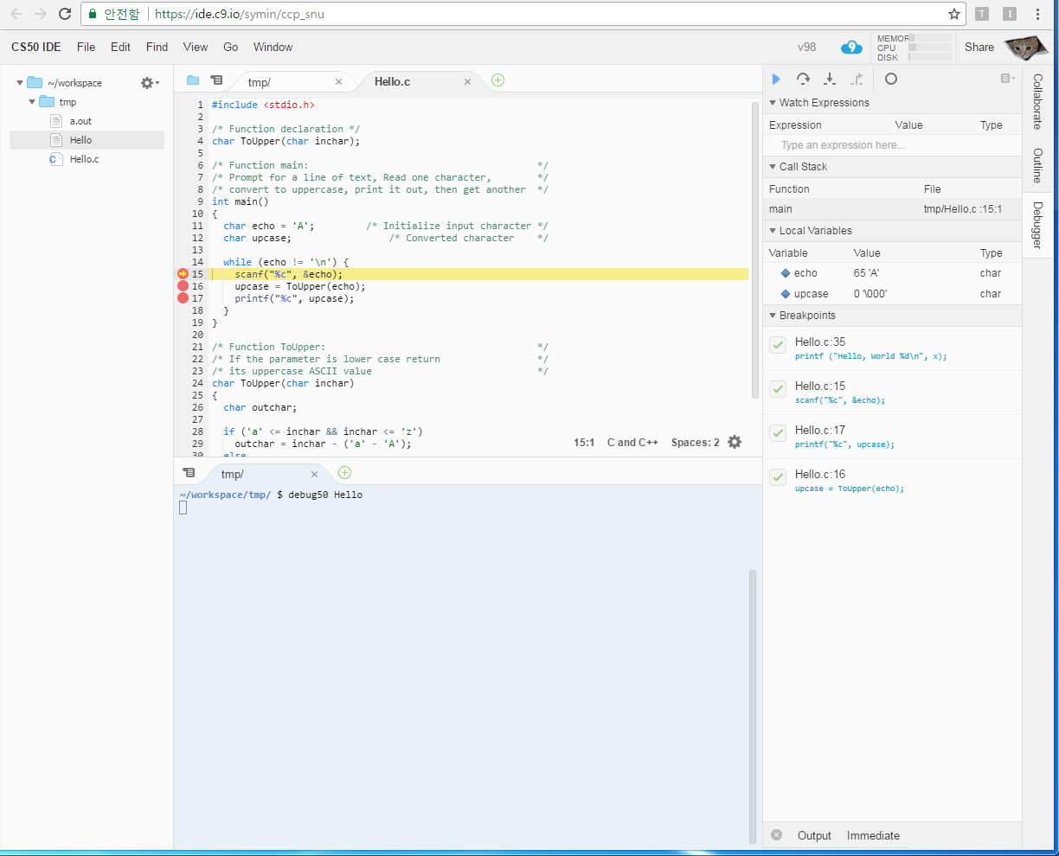
Source-Level Debugger
debug web page
of cloud 9
15-<number>

Slide 10
Source-Level Debugging Techniques
Breakpoints
  Stop when a particular statement is reached
  Stop at entry or exit of a function
  Conditional breakpoints:
  Stop if a variable is equal to a specific value, etc.
  Watchpoints:
  Stop when a variable is set to a specific value
Single-Stepping
  Execute one statement at a time
  Step "into" or step "over" function calls
    Step into: next statement is first inside function call
    Step over: execute function without stopping
    Step out: finish executing current function
    and stop on exit
15-<number>

Slide 11
Source-Level Debugging Techniques
Displaying Values
  Show value consistent with declared type of variable
  Dereference pointers (variables that hold addresses)
    See Chapter 17
  Inspect parts of a data structure
    See Chapters 19 and 17
15-<number>

Slide 12
Programming for Correctness
Accurate Specification
Modular Design
Defensive Programming
  Comment your code
  Adopt a consistent coding style
  Avoid (unsubstantiated) assumptions
  Avoid global variables
  Reply on the compiler (let the compiler generate as many warning messages as possible)
  …
15-<number>

Slide 13
꼭 기억해야 할 것
Type of errors
  Syntactic errors
  Semantic errors
  Algorithmic errors
Testing
  Black-box testing
  White-box testing
Source-level debugger
  Breakpoints
  Single-stepping
  Displaying values
Programming for correctness
  Accurate specification
  Modular design
  Defensive programming
15-<number>

